Slide 1

Geovisualization
WS 2023/24
Organisational, Conception, Outline
Dr. Andreas Müller
muellea@uni-trier.de
Room: F27
Consulting Hours: by arrangement

Slide 2
Organisational
Course is part of the Geoinformatics teaching program
Master Geoinformatics
Master Prozessdynamik der Erdoberfläche
Students from other disciplines
Structure:
lectures: In a short form: "live", all material online for self study
exercises: Introduction, demonstration and discussion "live"
StudIP: All materials from lectures and exercises, discussion, exchange
portfolio: Form of examination by documenting and assessing of your learning progress

Slide 3
Organisational: Schedule
Week 01 23.10.2023 today
Week 02 30.10.2023
Week 03 06.11.2023
Week 04 13.11.2023
Week 05 20.11.2023
Week 06 27.11.2023
Week 07 04.12.2023
Week 08 11.12.2023
Week 09 18.12.2023
X-mass holidays
Week 10 08.01.2024
Week 11 15.01.2024
Week 12 22.01.2024
Week 13 29.01.2024
Week 14 05.02.2024
Week 15 12.02.2024

Slide 4
Organisational: Software
CIP-Pool and Home use
Windows only (because of ArcGIS)
GIS: ArcGIS Pro, QGIS
We need to install ArcGIS Pro und QGIS, if working at home
QGIS: Download from official site or use the GIS-Stick, a Software-Collection installable on an USB-Memory device, includes QGIS.
ArcGIS: I will check your member status on arcgis.com and, if needed, you're registered using your universities user account
All information about software is on StudIP!

Slide 5
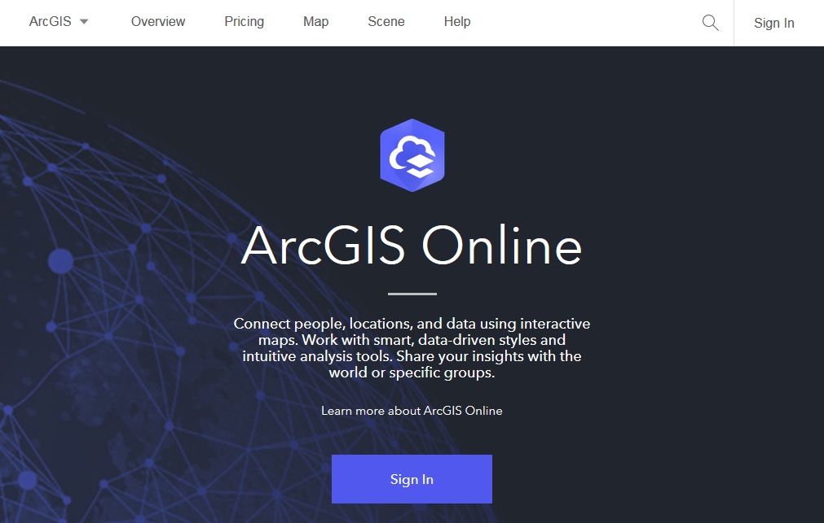
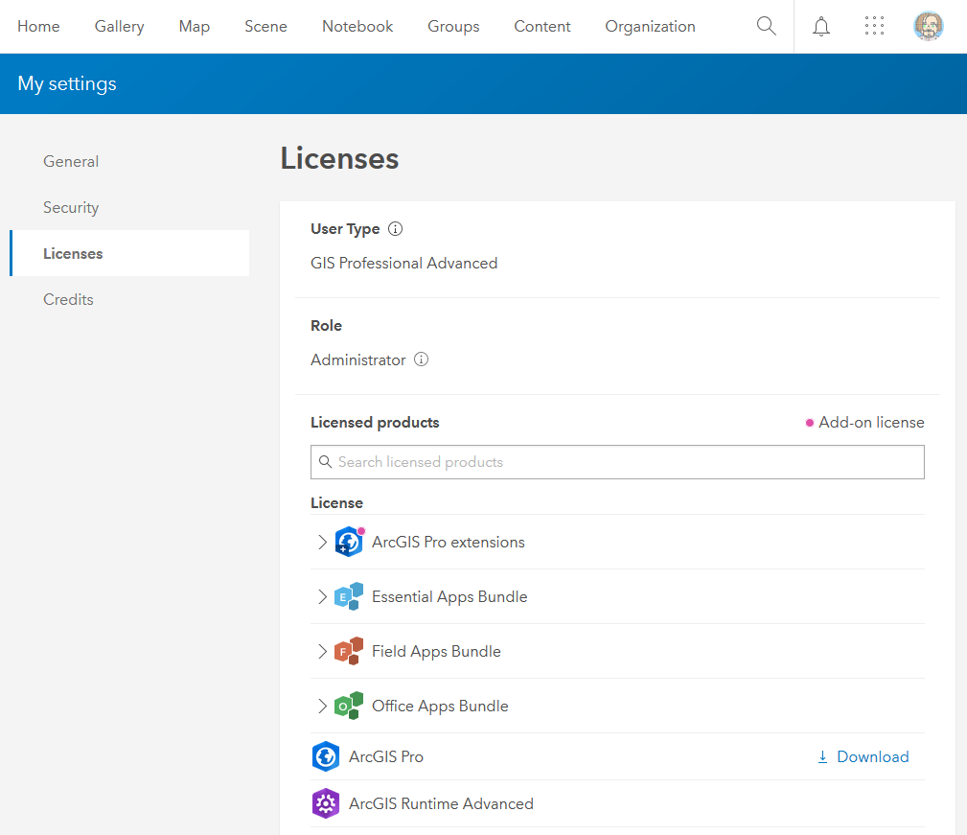
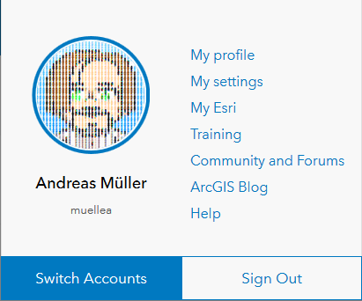
Membership on arcgis.com
After you got your user account (email!), you can visit https://www.arcgis.com
Log in
Click on your avatar,
choose "My settings"
click on "Licenses"
You'll find a download link for ArcGIS Pro there (for a install on your computer)
Once installed, check for updates inside the software

Slide 6
Conception
GIS (Software)
Web-Development
Theory of Geovisualization
Data (data types and processing)
Thematic Cartography
Visualization (methodology)
Web and Web-Mapping
Applications in Spatial Science
Application Topics:
Flood Risks of the City of Trier, Soil Erosion in Kenia
Tools
Theory
Methodology

Slide 7
A Typical Session
Course of a session
In week 3 we start with some theory, where I explain the topic of the class
I'll also present the exercise for that week,
inkl. what data we use,
the type of processing we'll perform and
the form of visualisation we are going to create.
You will be able to work on the topic of the week,
in your own speed
with time to ask questions and try variants.
It would be ideal if you go in groups
to do the exercises and
make progress together!

Slide 8
Examination
Please register on Porta for the examination
You can register and deregister up to the day before the deadline
Deadline for the transmission of your Portfolio is (prob.) March, 31, 2024.
Details for the transmission will be given at the end of the course.
Type of examination is a Portfolio, which means you will
document your learning progress
carry out a self-assessment and deal critically with the content of the course
build and submit the portfolio as a HTML-Website
Portfolio can be either in English or German,
If working in groups, please have, at least, your own text.

Slide 9
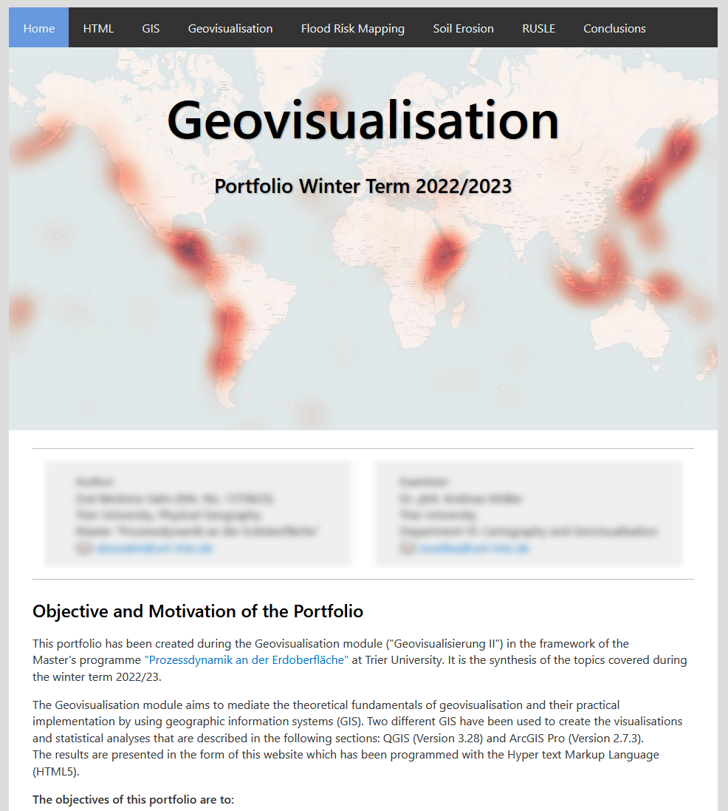
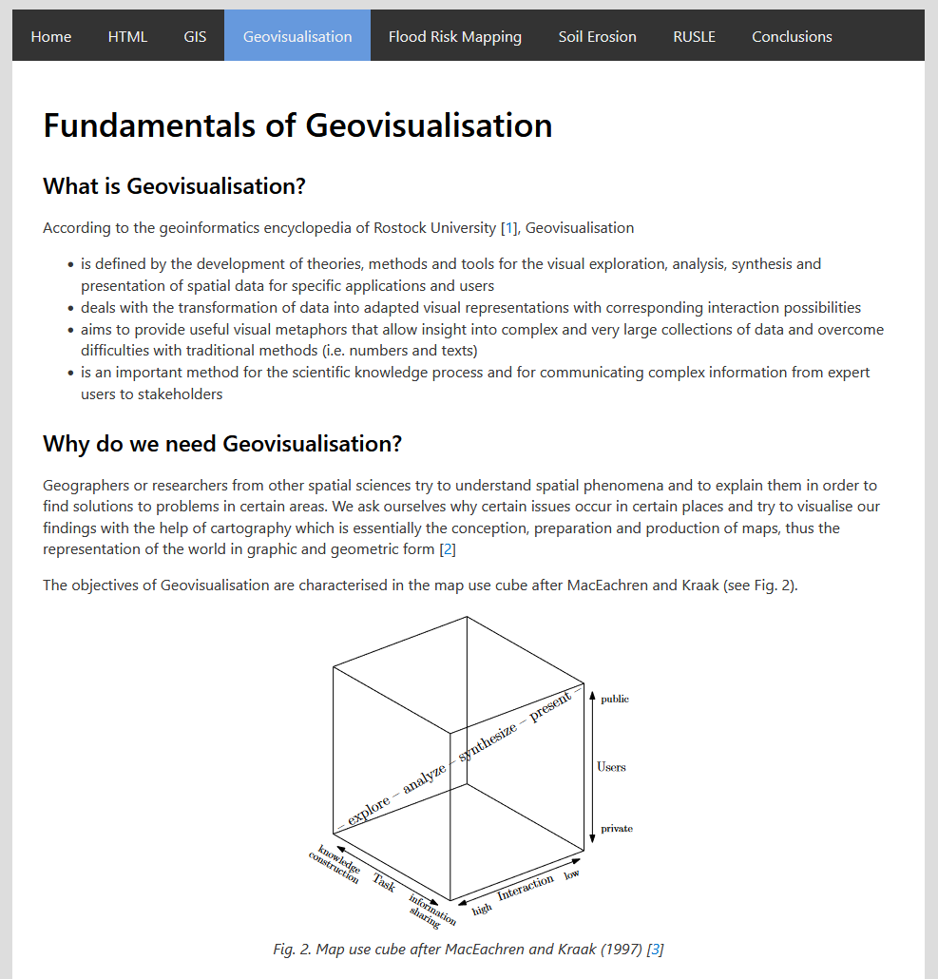
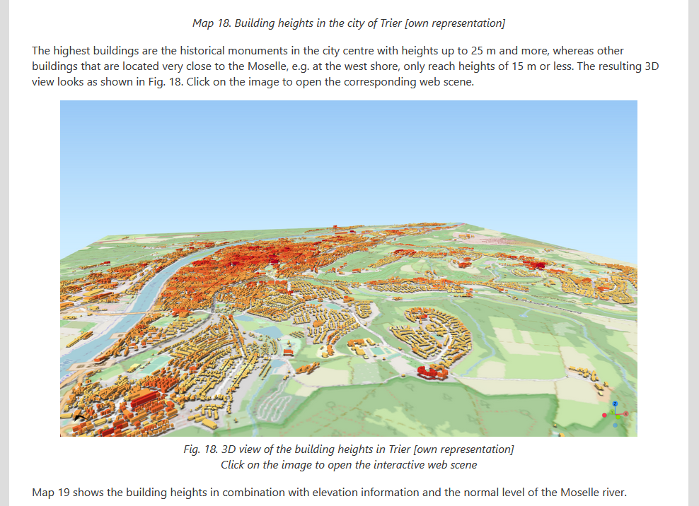
Example for a HTML-Portfolio
A very fine Portfolio presentation made in HTML using a template provided within the course.

Slide 10
Preparing yourself for the next session
Week 2 is a little excursion into HTML-Programming:
Portfolio will be an HTML-Presentation
It will be more dynamic and interactive than a PDF
A template page exists, describing the elements we'll need
Maps and other media from exercises will be embedded
To be prepared you may consult:
https://www.w3schools.com/html/html_intro.asp
https://wiki.selfhtml.org/wiki/HTML/Tutorials/Einstieg (German)
Look into Week 2 on StudIP to see what's coming next!

Slide 11
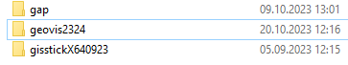
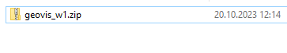
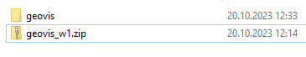
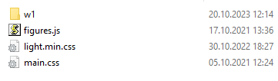
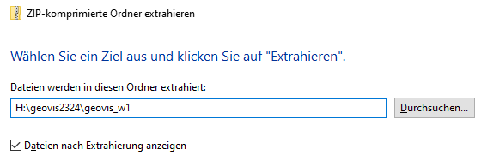
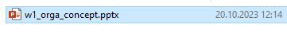
Structure of your "Workspace"
You'll need a structure to manage all the files, GIS-projects, maps and other material.
My USB-Drive with the directory geovis2324
Download the material for this week from StudIP
Extract the zip-file into a directory on your U:\-Drive, or, even better, on a USB-Drive (will be faster than U:\ in almost all cases)
Zip-file contents will "add" to the structure from week to week
Inside the zip-file there is a directory "geovis" with a folder for each session
I copied the zip-file for week 1 into the directory geovis2324
Once extracted, there will be another directory: geovis
Depending on the zip-Software you use, search for an option to extract only the contents of the zip file and not creating another folder with name of the zip file!
Windows build-in "extract" function
Here we find the files for week 1, a Powerpoint-Presentation:
X
only: H:\geovis2324

